Slide 1
ALOS PALSAR On The Fly Data Processing and Download System

Slide 2
Background
A new PALSAR data On-the-fly (OTF) processing and dissemination system has been developed. This will allow end-users to gain direct access to ESA’s ALOS PALSAR archive, without the need to interface with the ESA Order Desk.
The service will provide access to PALSAR (initially FBS, FBD and PLR. WB1 at a later stage) L1 high-resolution data:
RAW (JAXA Lv.1.0)
SLC (JAXA Lv.1.1)
GDH (JAXA Lv.1.5)
GEC (JAXA Lv.1.5)

Slide 3
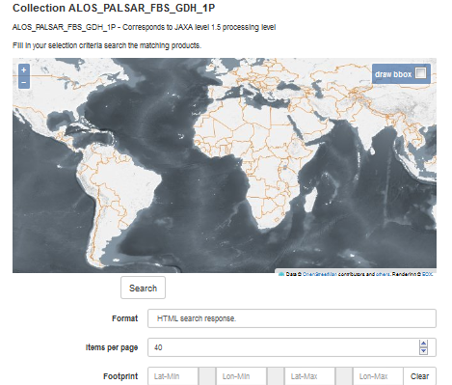
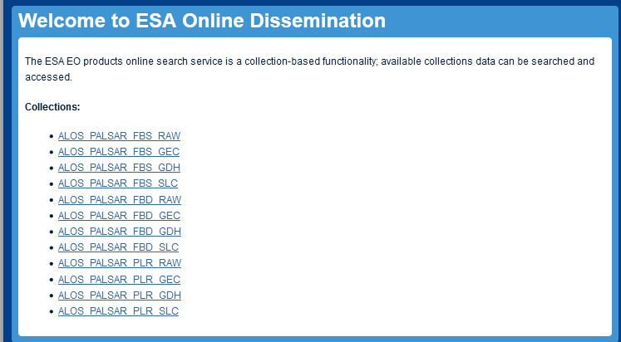
Accessing the ALOS PALSAR On-The-Fly (OTF) data
The OTF collections are available:
via the OADS interface at https://alos-palsar-ds.eo.esa.int/oads/access
through 3 mechanisms:
Via SO-CAT interface - search catalogue
Via OADS - Tree view
Via OADS – Filename search
In all cases, data can be viewed by anyone but downloaded only after subscription for ALOS PALSAR products on product page

Slide 4
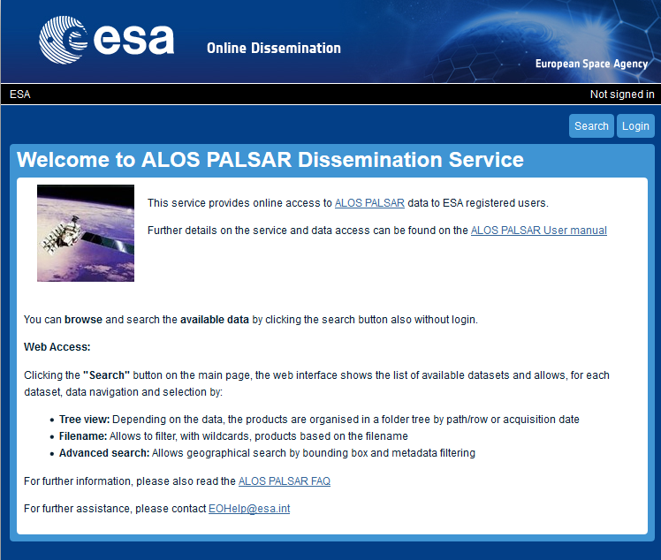
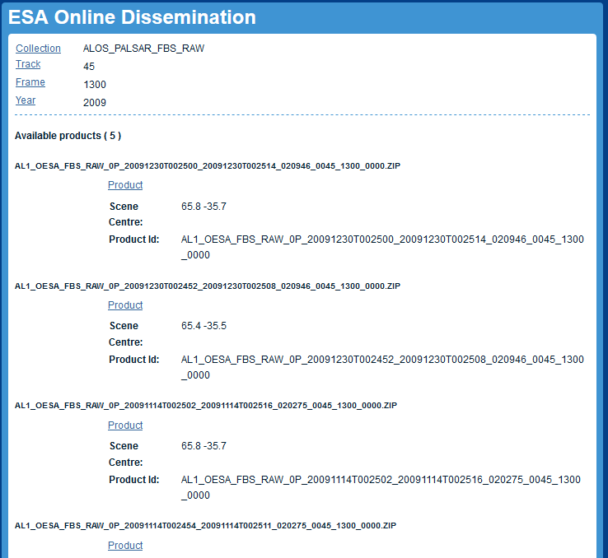
How the ALOS PALSAR On-The-Fly system works Tree view
Press the “login” button on the top-right and log in using your SSO ID (the system will check your authorisation).
Click on a collection then select “Search in collection by treeview”.
Select the track (JAXA OBS track #)
Select the Frame (JAXA scene centre frame #)
The list of the available products is shown:
Click on “Product” to start the download (if the product is already available the download will start immediately, otherwise the foreseen time of the download start is shown)

Slide 5
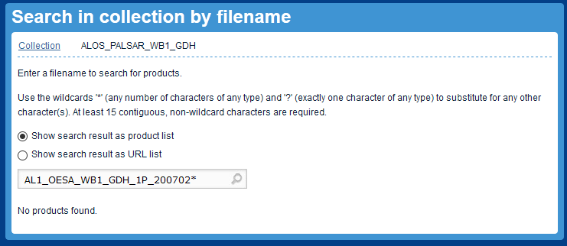
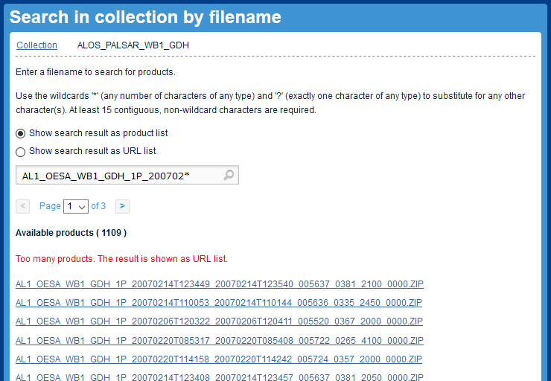
How the ALOS PALSAR system works Filename search
Press the “login” button on the top-right and log in using your SSO ID (the system will check your authorisation).
Click on a collection then select “Search in collection by filename”.
Enter the full filename to search or use wildcards '*' (any number of chars) ; '?' (exactly one character of any type) to substitute for any other character (e.g. to find all WB1 GDH products for Feb 2007 type: AL1_OESA_WB1_GDH_1P_200702*)
Click on the product filename to start the download (if the product is already available the download will start immediately, otherwise the foreseen time of the download start is shown)

Slide 6
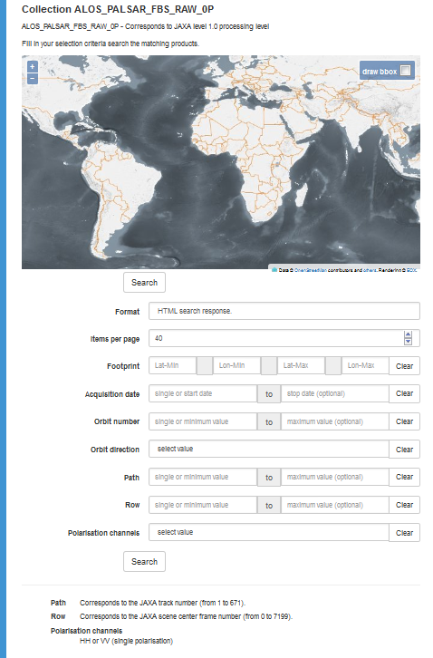
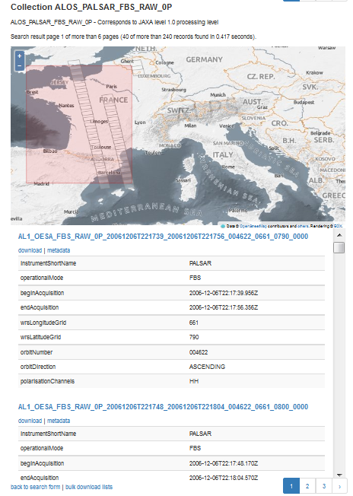

How the ALOS PALSAR system works SO-CAT search
Press the “login” button on the top-right and log in using your SSO ID (the system will check your authorisation).
Click on a collection then select “Advanced search”.
Enter your search parameters by:
Clicking “draw bbox” to draw you Area Of Interest on the map
Filling the search parameters at your convenience
Note that the number of items per page is the number of items which will be displayed in the result view
The result window shows the searched products on that map and a list of them with metadata overview
Note that the products shown in the result window can be presented on different pages.
Click on the page numbers on the top right corner to see other products resulting from the search.
Click on a product footprint on the map to highlight the product from the list, and conversely
Click on “metadata” link to view the detailed metadata of a product
Click on “download” to get (if the product is already available the download will start immediately, otherwise the foreseen time of the download start is shown)

Slide 7
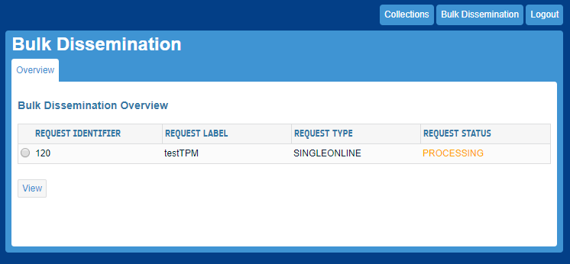
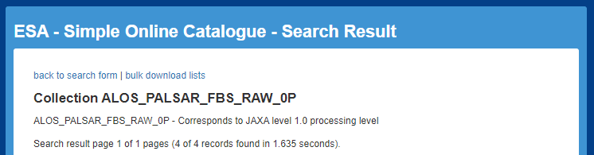
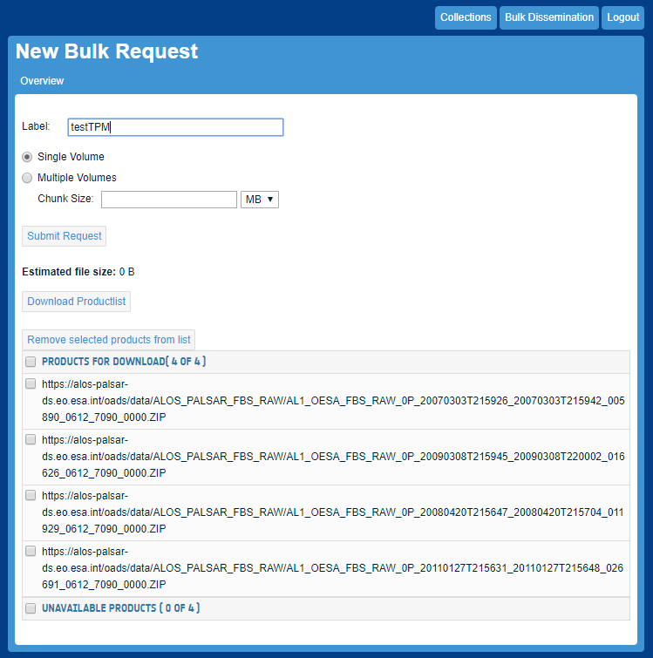
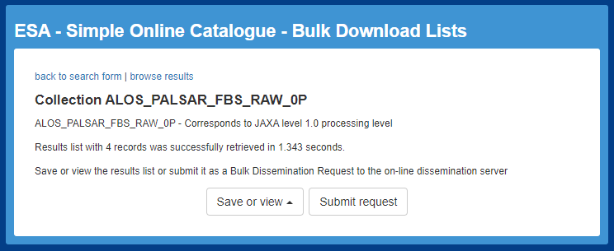
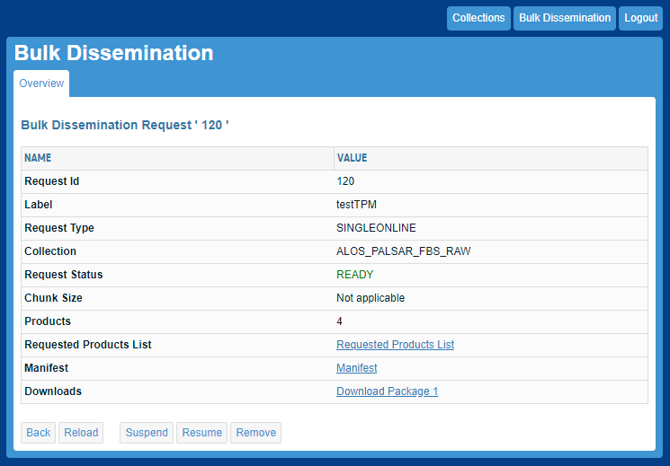
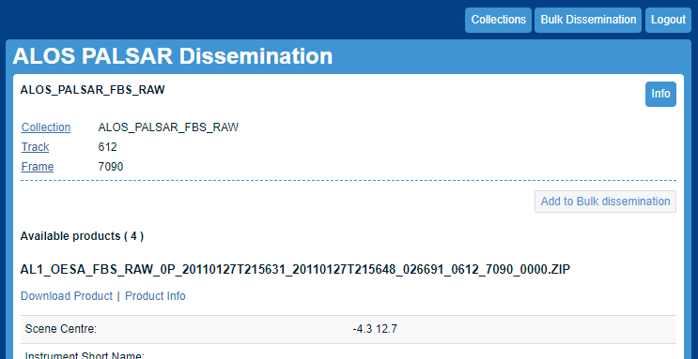
How the ALOS PALSAR system works Bulk dissemination
The user is allowed to download a set of data all at once by using the Bulk Download functionality (enabled only with user logged in).
In SO-CAT Search Result page, press “bulk download lists” link. Then press “Submit request” button
In OADS, press “Submit request” button to include all products in the page into the Bulk Request
The New Bulk Request overview page is opened
Set the identification name of the request in ‘Label’ field by using alpha-numeric characters
Select the Single/Multiple volume option to choose between the data download in one shot or in packages with pre-defined size
Manage the request: “Download Productlist” to get the product list in txt format before request submission; “Remove selected products from list” to cancel the selected products from the list before request submission
Submit the request
After bulk request submission, the user will get the request status. If the processing is successful the request status will change to READY; If the processing is not completely successful the request status will change to PARTIAL; If the processing is not successful the request status will change to FAILED
Select the Request Identifier radio button and press “View”.
The View request page is shown including: product _List, Manifest, Unavailable product List (if issued) in txt format. the ‘Download package’ button to start products package(s) download.
The buttons in the lower bar (‘Suspend’, ‘Resume’, ‘Remove’) allow to manage the request
2
7
3
4
8
1. SO-CAT
6
5
1. OADS
10
9

Slide 8
ESA Naming Convention
The product filename is composed by: <SSS>_<CCCC>_<TTTTTTTTTT>_<yyyymmddThhmmss>_<YYYYMMDDTHHMMSS>_<oooooo>_<tttt>_<ffff>_<vvvv>.ZIP
Element | Description | Example or value list
SSS | MissionID | AL1
CCCC | Originator | OESA
TTTTTTTTTT | Product/File Type | FBS_RAW_0P ; FBD_RAW_0P PLR_RAW_0P ; WB1_RAW_0P FBS_SLC_1P ; FBD_SLC_1P PLR_SLC_1P ; FBS_GEC_1P FBD_GEC_1P ; PLR_GEC_1P WB1_GEC_1P ; FBS_GDH_1P FBD_GDH_1P ; PLR_GDH_1P WB1_GDH_1P
yyyymmddThhmmss | Start time (year month day ‘T’ hours minutes seconds) | e.g. 20090315T001015
YYYYMMDDTHHMMSS | Stop time ( “ “ ) | e.g. 20090315T001031
oooooo | Orbit (since launch) | e.g. 071618
tttt | Track (JAXA OBS track #) (1-671) | e.g. 0042
ffff | Frame (JAXA scene centre #) (0-7199) | e.g. 2100
vvvv | Version | e.g. 0000

Slide 9
Quality of Service
In order to provide a good quality of service, at the subscription to ALOS PALSAR data, a default user profile will be assigned to the user (Standard User).
According to the available resources and workload, the user could have a per day quota.
The number of downloadable products per day is initially fixed to 20 products per collection.
An user can ask a profile upgrade to EOHelp in order to increase the daily quota
If, during a request, you have exhausted your daily quota you will receive an error message.

Slide 10
Production failures and feedback
If a failure occurs, please refer to the ALOS PALSAR FAQ page
For further assistance, please contact eohelp@esa.int

